Slide 1
Dual Nature of Light
High School Physics
Unit 12
Notes:
NAD 2023 Standard ER1 (Electromagnetic Radiation)

Slide 2
Credits
This Slideshow was developed to accompany the textbook
  OpenStax High School Physics
    Available for free at https://openstax.org/details/books/physics
    By Paul Peter Urone and Roger Hinrichs
    2020 edition
Some examples and diagrams are taken from the OpenStax College Physics, Physics, and Cutnell & Johnson Physics 6th ed.
Slides created by
Richard Wright, Andrews Academy
rwright@andrews.edu

Slide 3
12-01 The Double Slit Experiment
In this lesson you will…
Explain the double slit experiment
Calculate the double slit diffraction pattern
Notes:
OpenStax High School Physics 17.1-2
OpenStax College Physics 2e 27.1-27.3

Slide 4
12-01 The Double Slit Experiment
Wave Character of Light
  When interacts with object several times it’s wavelength, it acts like a ray
  When interacts with smaller objects, it acts like a wave

Slide 5
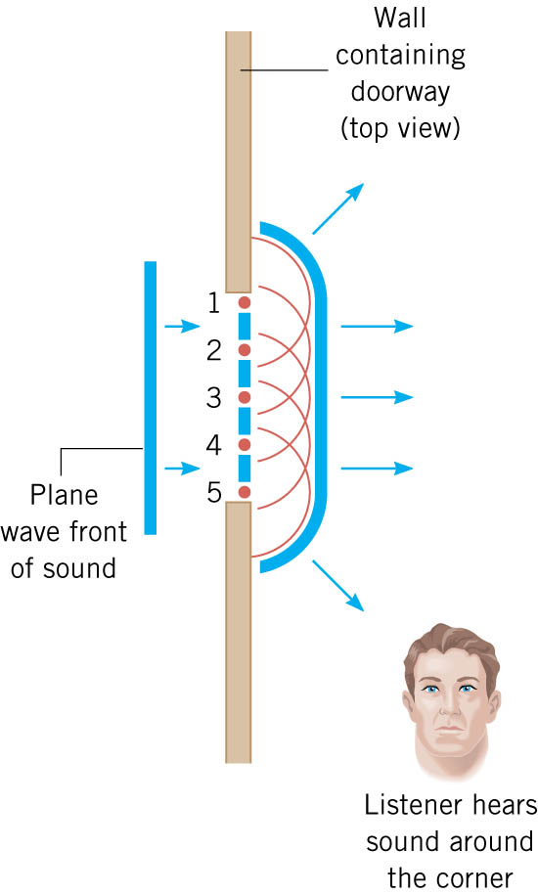
12-01 The Double Slit Experiment
Huygens’ Principle
  Every point on a wave front acts as a source of tiny wavelets that move forward with the same speed as the wave; the wave front at a later instant is the surface that is tangent to the wavelets.

Slide 6
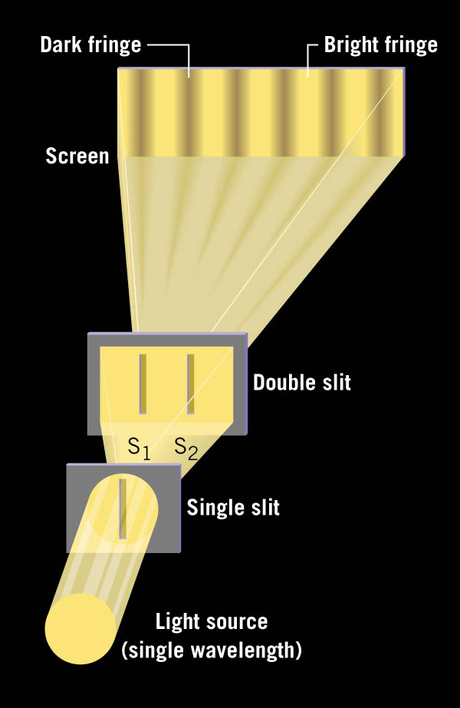
12-01 The Double Slit Experiment
In 1801, Thomas Young showed that two overlapping light waves interfered and was able to calculate wavelength.
Notes:
Have laser and double slit for demo (optics bench?)

Slide 7
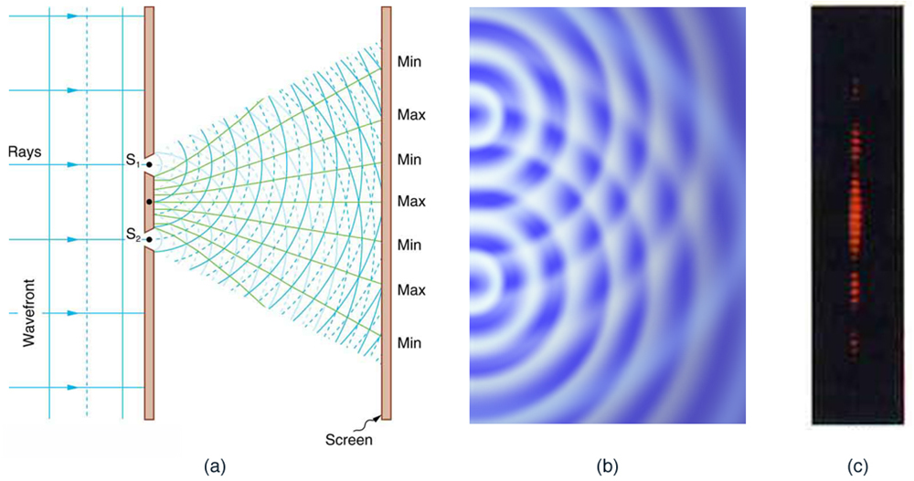
12-01 The Double Slit Experiment

Slide 8
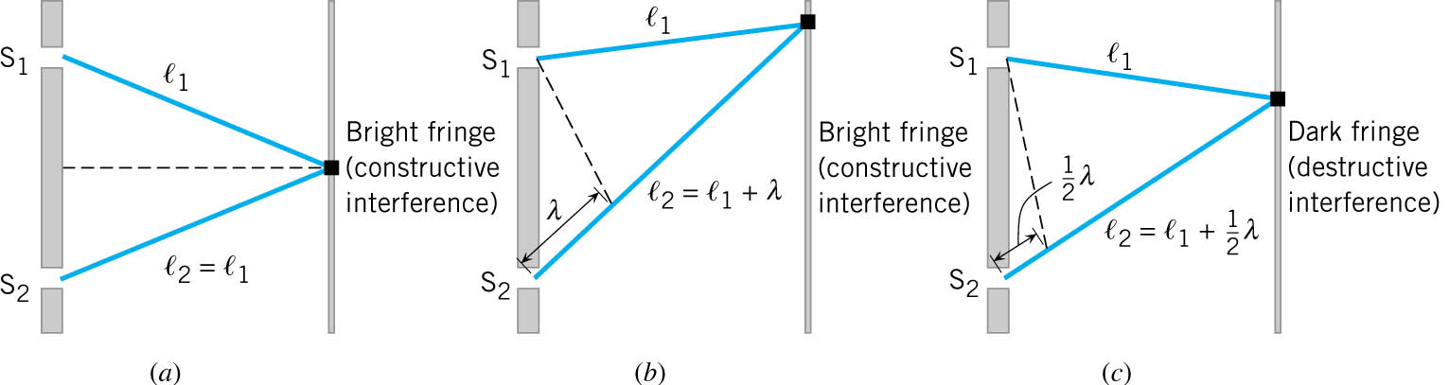
12-01 The Double Slit Experiment
Bright fringe where ℓ₁ − ℓ₂ = mλ
Dark fringe where ℓ₁ − ℓ₂ = (m + ½)λ
Brightness of fringes varies
  Center fringe the brightest and decreases on either side

Slide 9
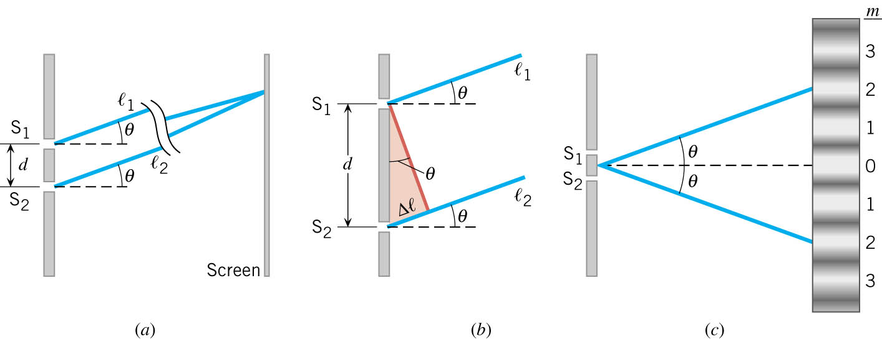
12-01 The Double Slit Experiment
A) Rays from slits S₁ and S₂, which make approximately the same angle θ with the horizontal, strike a distant screen at the same spot.
B) The difference in the path lengths of the two rays is Δℓ = d sin θ.
C) The angle θ is the angle at which a bright fringe (m = 2, here) occurs on either side of the central bright fringe (m = 0)

Slide 10

12-01 The Double Slit Experiment
Δℓ = d sin θ
Bright fringe Δℓ = mλ
  d sin θ = mλ
  $$\sin{θ}=m\frac{λ}{d}$$
Dark fringe Δℓ = (m + ½)λ
  d sin θ = (m + ½)λ
  $$\sin{θ}=\left(m+\frac{1}{2}\right)\frac{λ}{d}$$
Notes:
θ = angle between fringe and center
m = integer
λ = wavelength
d = distance between slits

Slide 11
12-01 The Double Slit Experiment
A laser beam (λ = 630 nm) goes through a double slit with separation of 3 μm. If the interference pattern is projected on a screen 5 m away, what is the distance between the third order bright fringe and the central bright fringe?
4.06 m
5m
laser
m=0
39.0501°
x
m=3
Notes:
$$\sin{θ}=m\frac{λ}{d}→\sin{θ}=3\frac{630×{10}^{−9} m}{3×{10}^{−6} m}→\sin{θ}=0.63→θ=39.0501°$$
$$\tan{39.0501°}=\frac{x}{5 m}→5 m \left(\tan{39.0501°}\right)=x=4.06 m$$

Slide 12
12-01 Practice Work
Don’t let your other work interfere with these problems.
Read
  OpenStax College Physics 2e 27.4
  OR
  OpenStax High School Physics 17.1-2

Slide 13
12-02 Multiple Slit Diffraction
In this lesson you will…
• Discuss the pattern obtained from diffraction grating.
• Explain diffraction grating effects.
Explain Single-Slit Diffraction
Notes:
OpenStax High School Physics 17.1-2
OpenStax College Physics 2e 27.4

Slide 14
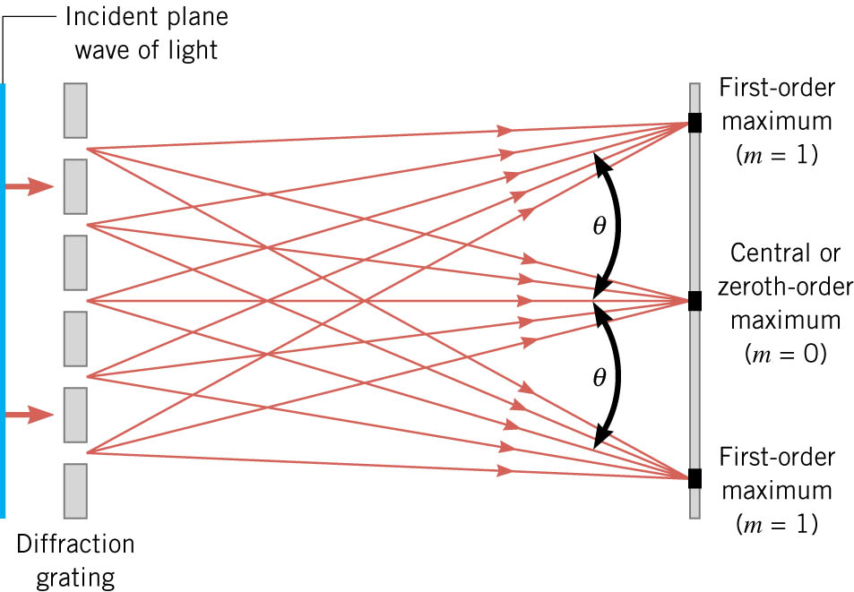
12-02 Multiple Slit Diffraction
Arrangement of many closely spaced slits
As many as 40,000 slits per cm
Produces interference patterns
Notes:
Have a couple diffraction gratings to play with

Slide 15
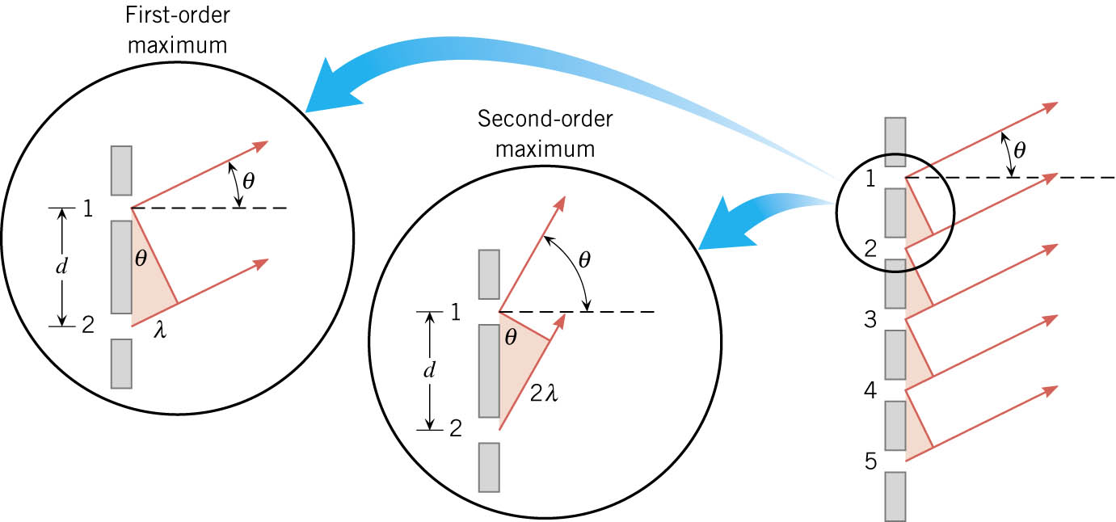

12-02 Multiple Slit Diffraction
The light rays are essentially parallel.
The principal maxima occur when light from one slit travels mλ more to meet light from a 2nd slit producing constructive interference.
Principal maxima
$\sin{θ}=m\frac{λ}{d}$

Slide 16

12-02 Multiple Slit Diffraction
A laser which produces 650 nm light shines through a diffraction grating. An interference pattern is produced on a screen 50 cm away. The distance on the screen between the second order maxima and the center is 13.5 cm. What is the slit separation in the grating?
  $4.99×{10}^{−6}$ m
13.5 cm
15.11°
50 cm
Notes:
$$\tan{θ}=\frac{13.5 cm}{50 cm}→θ=\tan^{−1}{\frac{13.5}{50}}=15.11°$$
$$\sin{θ}=m\frac{λ}{d}→\sin{15.11°}=2\frac{650×{10}^{−9} m}{d}→d=2\frac{650×{10}^{−9} m}{\sin{15.11°}}=4.99×{10}^{−6} m$$

Slide 17
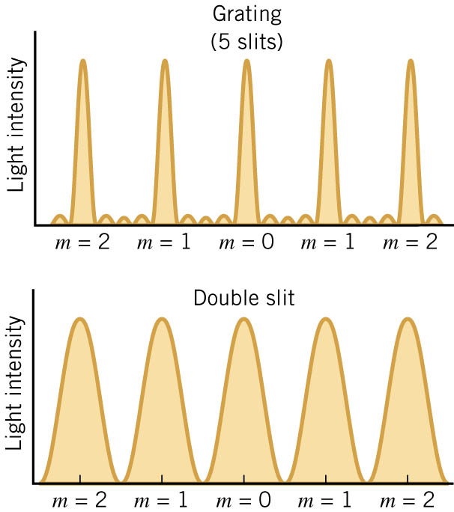
12-02 Multiple Slit Diffraction
Diffraction gratings produce narrower, more defined maxima, but have small secondary maxima in between.

Slide 18
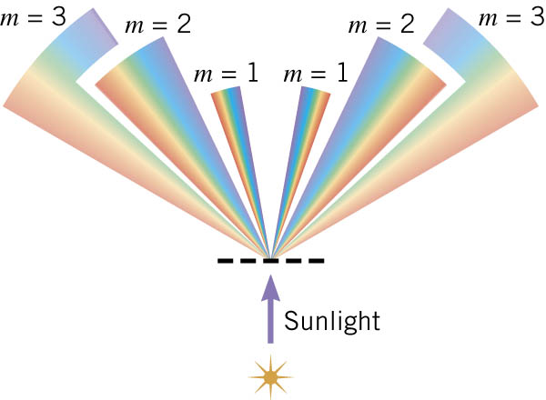
12-02 Multiple Slit Diffraction
Splitting colors
  Each color of light is a different wavelength, so each color bends a different angle.
  Which color bends the most?
    Red
  Which color bends the least?
    Violet

Slide 19
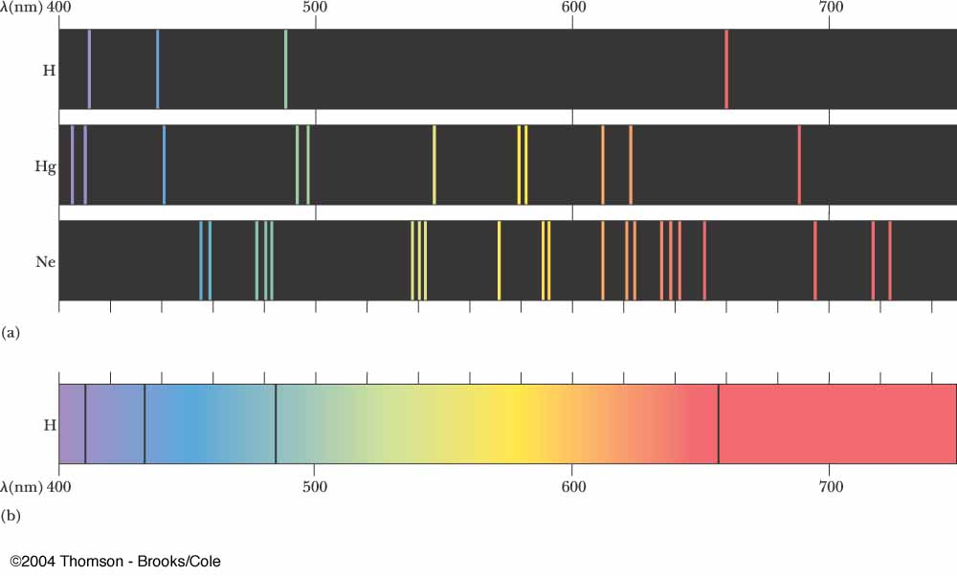
12-02 Multiple Slit Diffraction
Application - Determining Elements in Stars
  Each element in a hot gas emits or absorbs certain wavelengths of light.
  By using a diffraction grating the light can be split and the wavelengths measured.
Notes:
Top is an emission spectra of Neon
Bottom is an absorption spectra of Hydrogen

Slide 20
12-02 Practice Work
I hope you don’t find these problems grating.
Read
  OpenStax College Physics 2e 27.5-27.6
  OR
  OpenStax High School Physics 17.1-2

Slide 21
12-03 Single Slit Diffraction
In this lesson you will…
Explain Single-Slit Diffraction
Find the limits of resolution
Notes:
OpenStax High School Physics 17.1-2
OpenStax College Physics 2e 27.5-27.6

Slide 22
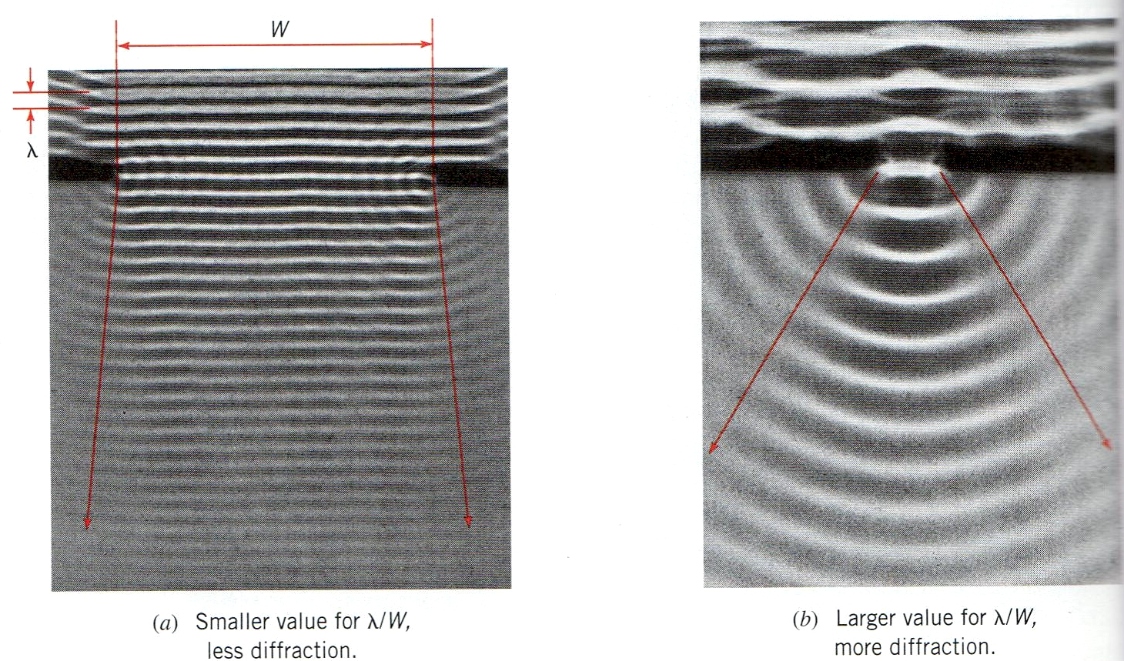
12-03 Single Slit Diffraction
Large opening → small bend
Small opening → large bend

Slide 23
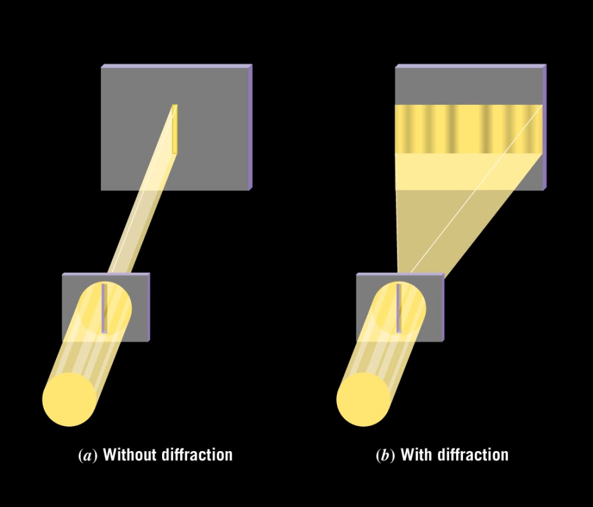
12-03 Single Slit Diffraction
Single slit produces a diffraction pattern
The Huygens wavelets interfere with each other
The center bright band is twice width of the other bands.

Slide 24
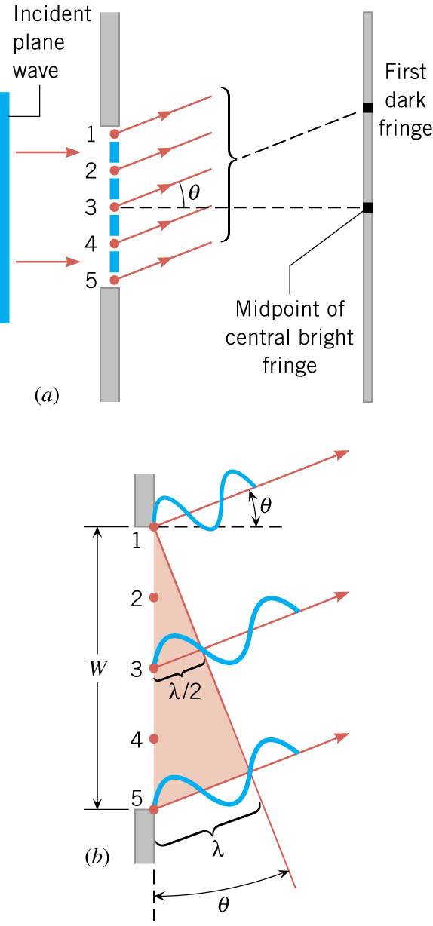
12-03 Single Slit Diffraction
First order dark band occurs when left edge and right edge path lengths differ by 1 wavelength.
The center wave path length differs by ½ wavelength leading to the destructive interference.
The wavelet slightly below #1 will cancel with wavelet slightly below #3 and so on.
Notes:
The screen is far from the single slit so that wavelets are parallel. We are looking at the part of the wavelets that are traveling at an angle to the normal.

Slide 25
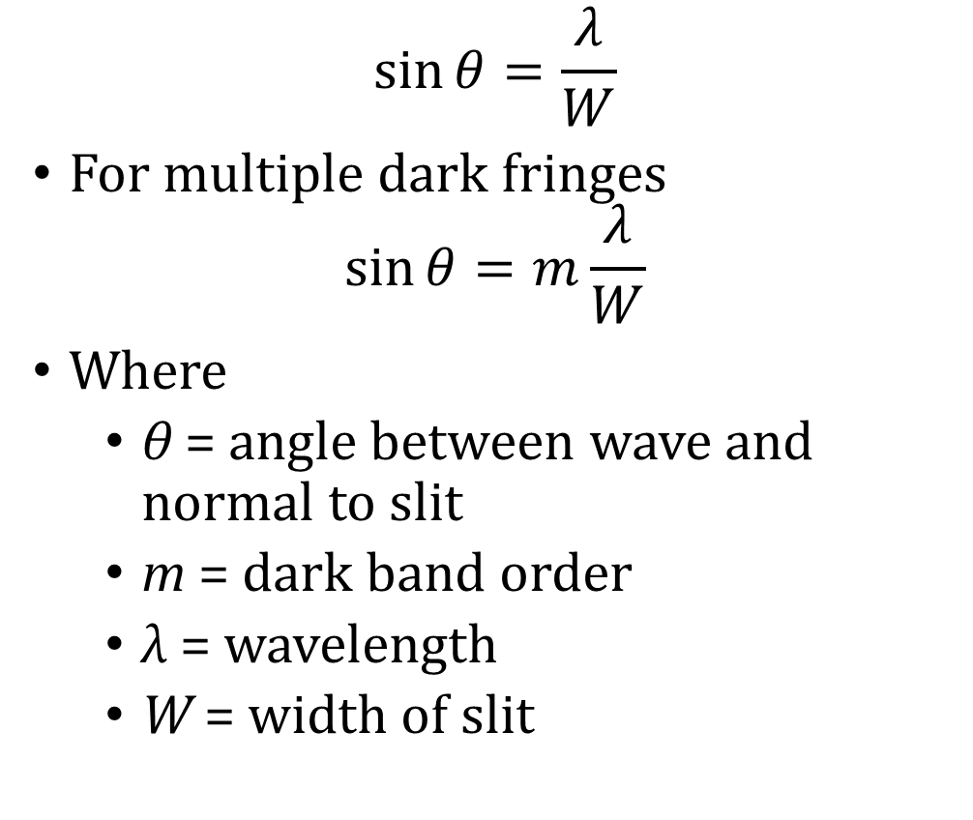
12-03 Single Slit Diffraction
$$\sin{θ=\frac{λ}{W}}$$
For multiple dark fringes
$$\sin{θ}=m\frac{λ}{W}$$
Where
  θ = angle between wave and normal to slit
  m = dark band order
  λ = wavelength
  W = width of slit
Notes:
The screen is far from the single slit so that wavelets are parallel. We are looking at the part of the wavelets that are traveling at an angle to the normal.

Slide 26

12-03 Single Slit Diffraction
A laser shines through a single slit of width $3.25×{10}^{−6}$ m. The first order dark fringe is 10.2 cm from the center and the slit is 50 cm from the screen. What is the wavelength of the laser?
  650 nm
10.2 cm
11.53°
50 cm
Notes:
$$\tan{θ}=\frac{10.2 cm}{50 cm}→θ=\tan\left(\frac{10.2}{50}\right)=11.53°$$
$$\sin{θ}=m\frac{λ}{W}→\sin{11.53°}=1\frac{λ}{3.25×{10}^{−6} m }→6.496×{10}^{−7} m=λ$$

Slide 27
12-03 Single Slit Diffraction
Application – Microchip Production
  Very small electrical components are used.
  Make masks similar to photographic slides.
  Light shines through the mask onto silicon wafers coated with photosensitive material.
  The exposed portions are chemically removed later.
  If too much diffraction occurs, the lines will overlap.
  Currently UV rays which have smaller wavelengths than visible light is used to minimize λ/W ratio.
  To improve could use X-rays or Gamma Rays with even smaller wavelengths.

Slide 28
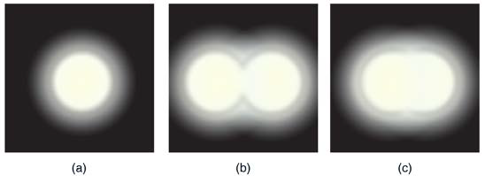
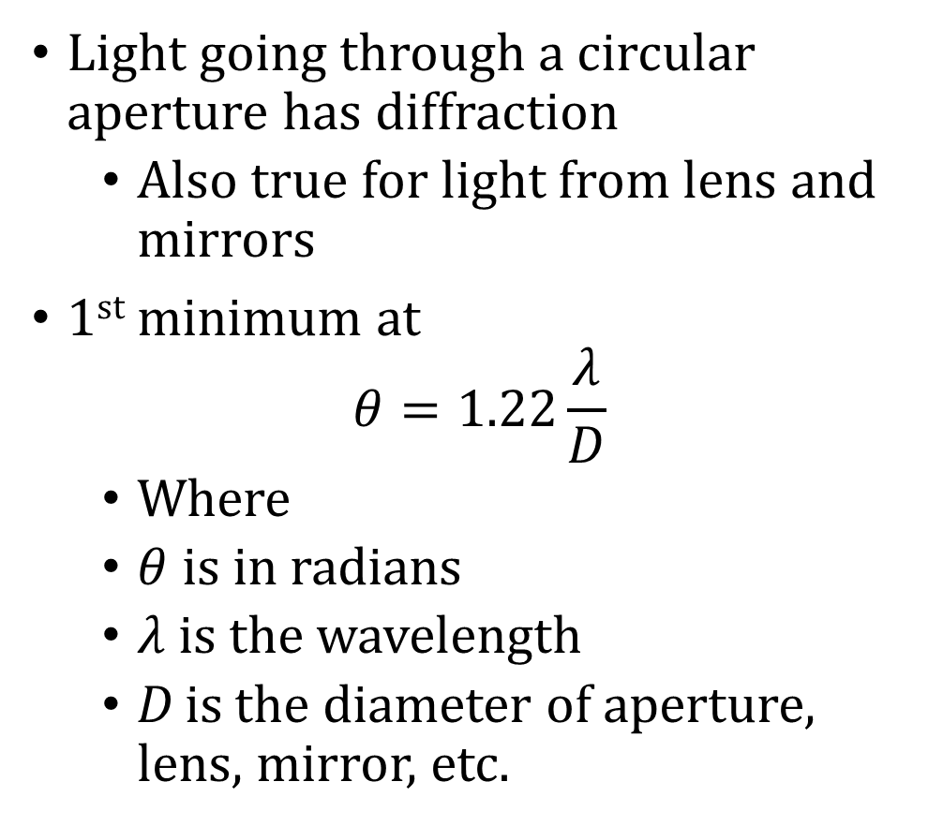
12-03 Single Slit Diffraction
Light going through a circular aperture has diffraction
  Also true for light from lens and mirrors
1st minimum at
$$θ=1.22\frac{λ}{D}$$
  Where
  $θ$ is in radians
  $λ$ is the wavelength
  D is the diameter of aperture, lens, mirror, etc.
The diffraction limits the amount of detail or resolution
Two images are just resolvable when the center of the diffraction pattern of one is directly over the first minimum of the other.

Slide 29
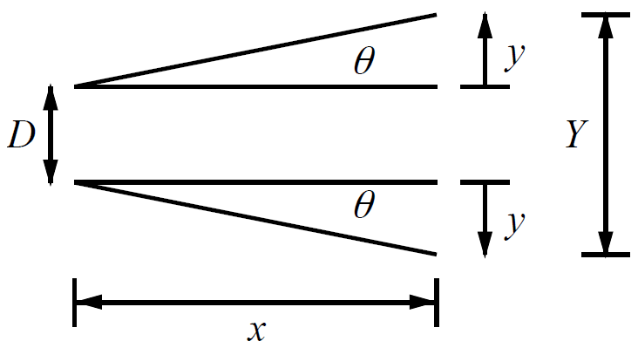
12-03 Single Slit Diffraction
(a) What is the minimum angular spread of a 633-nm wavelength He-Ne laser beam that is originally 1.00 mm in diameter? (b) If this laser is aimed at a mountain cliff 15.0 km away, how big will the illuminated spot be?
23.2 m
Notes:
$θ=1.22\frac{λ}{D}=1.22\frac{633×{10}^{−9} m}{1×{10}^{−3} m}=7.72×{10}^{−4} radians$
$\tan{θ}=\frac{y}{x}→\tan{7.72×{10}^{−4} rad}=\frac{y}{15000 m}→y=\left(15000 m\right)\tan{7.72×{10}^{−4} rad}=11.58 m$
$Y=2y+D=2\left(11.58 m\right)+1×{10}^{−3} m=23.2 m$

Slide 30
12-03 Practice Work
Don’t let frivolities interfere with your learning.
Read
  OpenStax College Physics 2e 29.1
  OR
  OpenStax High School Physics 21.1

Slide 31
12-04 Quantum Nature of Light
In this lesson you will…
Explain blackbody radiation
Explain the quantization of light
Notes:
OpenStax High School Physics 21.1
OpenStax College Physics 2e 29.1

Slide 32
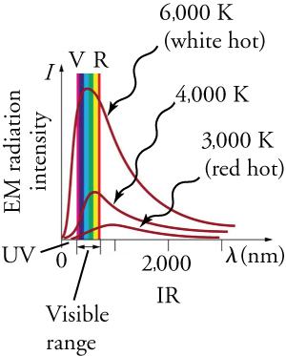
12-04 Quantum Nature of Light
It is hotter to wear black clothes in the sun than to wear white
Black absorbs all light
  It also re-emits that light
Blackbody
  Absorbs all light
  Re-emits all that light
The color that a hot object (blackbody) emits depends on its temperature.
Notes:
The peak shows what the most common wavelength that is emitted for a given temperature.

Slide 33
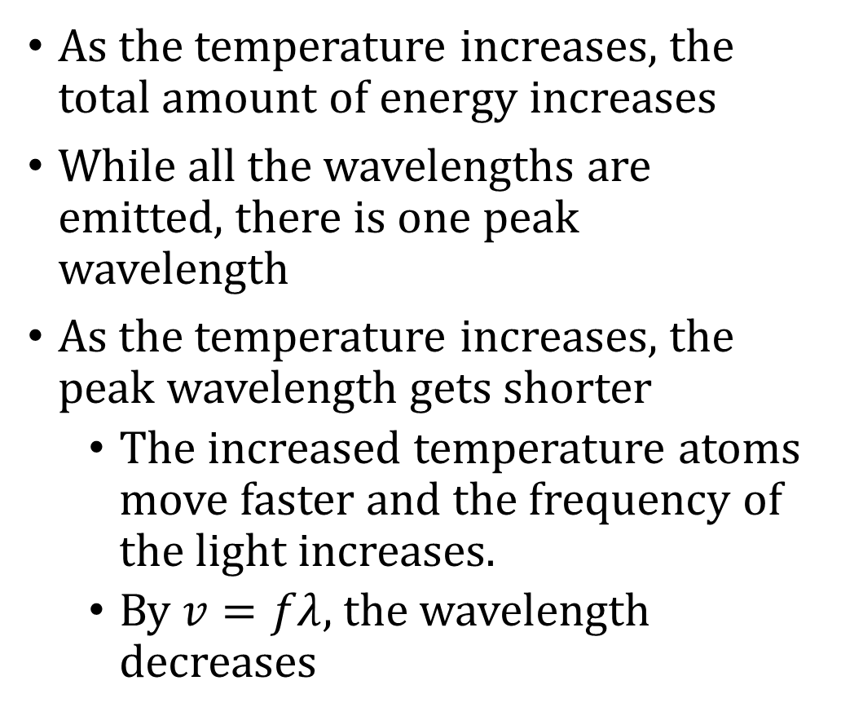
12-04 Quantum Nature of Light
As the temperature increases, the total amount of energy increases
While all the wavelengths are emitted, there is one peak wavelength
As the temperature increases, the peak wavelength gets shorter
  The increased temperature atoms move faster and the frequency of the light increases.
  By $v=fλ$, the wavelength decreases

Slide 34
12-04 Quantum Nature of Light
This graph does not match classical physics which is based on continuous energy
Planck invented the idea that the frequencies emitted are based on probabilities
Energy is quantum
  Only exists in certain amounts
  Like the number of electrons in something must be a whole number
  E = nhf

Slide 35
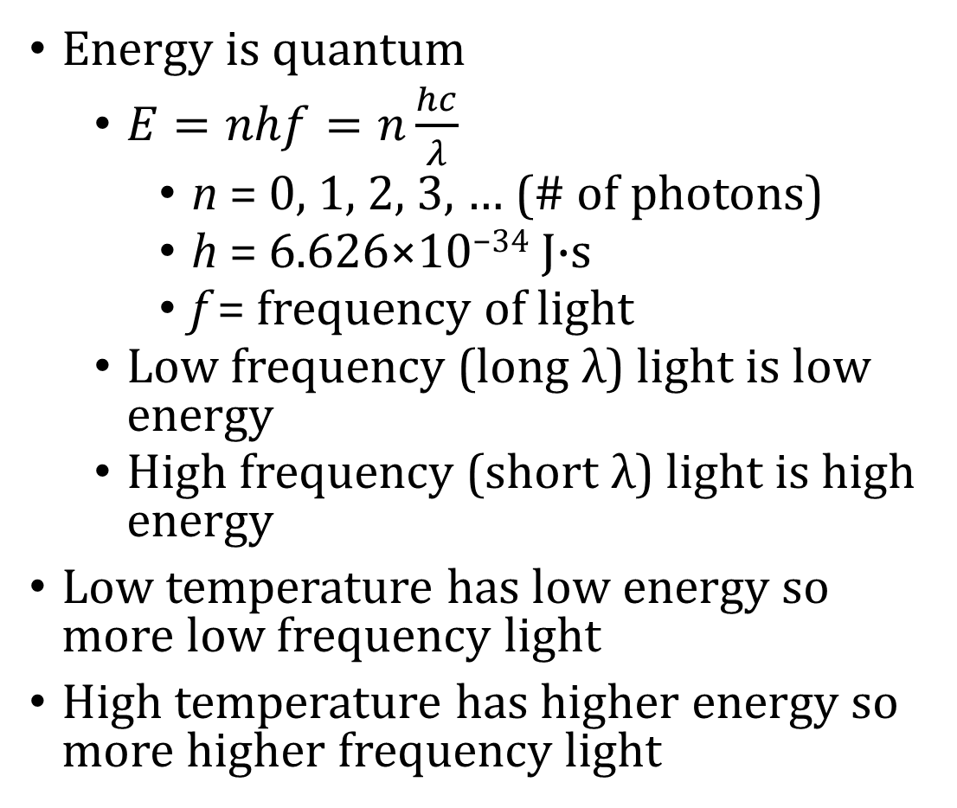
12-04 Quantum Nature of Light
Energy is quantum
  $E=nhf=n\frac{hc}{λ}$
    n = 0, 1, 2, 3, … (# of photons)
    h = 6.626×10⁻³⁴ J·s
    f = frequency of light
  Low frequency (long λ) light is low energy
  High frequency (short λ) light is high energy
Low temperature has low energy so more low frequency light
High temperature has higher energy so more higher frequency light
Notes:
h is Planck’s constant

Slide 36
12-04 Quantum Nature of Light
The idea of quantized energy earned Planck the Nobel Prize in physics
Other things that are quantized
  Atoms and molecules
  Charge
  Electrons

Slide 37
12-04 Quantum Nature of Light
How many photons per second does a typical 10W LED lightbulb produce if 80% of the electrical energy is turned into useable light with an average wavelength of 520 nm?
Notes:
$$E=nhf$$
$$c=fλ→f=\frac{c}{λ}$$
$$E=\frac{nhc}{λ}$$
$$\frac{E}{n}=\frac{hc}{λ}$$
$$\frac{E}{n}=\frac{\left(6.626×{10}^{−34} J·s\right)\left(3.00×{10}^{8}\frac{m}{s}\right)}{520×{10}^{−9} m}=3.82×{10}^{−19}\frac{J}{photon}$$
$$1 W=\frac{1 J}{s}$$
$$80\%\left(10 W\right)=8\frac{J}{s}$$
$$\frac{J}{s}÷\frac{J}{photon}=\frac{J}{s}·\frac{photon}{J}=\frac{photon}{s}$$
$$\left(8\frac{J}{s}\right)÷\left(3.82×{10}^{−19}\frac{J}{photon}\right)=2.09×{10}^{19} photons/s$$

Slide 38
12-04 Quantum Nature of Light
Compare the energy of one photon of UV light (λ = 250 nm) with IR light (λ = 890 nm).
Notes:
$$c=fλ→f=\frac{c}{λ}$$
$$E=nhf→\frac{E}{n}=\frac{hc}{λ}$$
UV
$$\frac{E}{n}=\frac{\left(6.626×{10}^{−34} J·s\right)\left(3.00×{10}^{8}\frac{m}{s}\right)}{250×{10}^{−9} m}=7.95×{10}^{−19}\frac{J}{photon}$$
IR
$$\frac{E}{n}=\frac{\left(6.626×{10}^{−34} J·s\right)\left(3.00×{10}^{8}\frac{m}{s}\right)}{890×{10}^{−9} m}=2.23×{10}^{−19}\frac{J}{photon}$$

Slide 39
12-04 Practice Work
Radiate the love of Jesus to the world.
Read
  OpenStax College Physics 2e 29.2-29.3
  OR
  OpenStax High School Physics 21.2

Slide 40
12-05 Photoelectric Effect
In this lesson you will…
Explain photoelectric effect
Find the maximum kinetic energy of electrons ejected from a material struck by light
Notes:
OpenStax High School Physics 21.2
OpenStax College Physics 2e 29.2-29.3

Slide 41
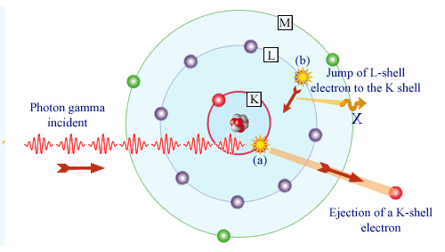
12-05 Photoelectric Effect
When a photon of light hits an electron, the electron absorbs the energy and jumps to a higher orbital
If the photon has enough energy, the electron can completely leave the atom
If there is a wire for the electrons to move through, then there will be a current
This the is photoelectric effect
Notes:
It is easier to eject electrons from the electron sea in a metal surface

Slide 42

12-05 Photoelectric Effect
Einstein discovered
  Light waves are not continuous streams
  They are made up of discrete quantum particles of energy called photons
Energy of photon from photoelectric effect is $E=hf=\frac{hc}{λ}$

Slide 43
12-05 Photoelectric Effect
For a given material, there is a threshold frequency f₀ for the EM radiation below which no electrons are ejected, regardless of intensity. Using the photon model, the explanation for this is clear. Individual photons interact with individual electrons. Thus if the energy of an individual photon is too low to break an electron away, no electrons will be ejected. However, if EM radiation were a simple wave, sufficient energy could be obtained simply by increasing the intensity.
Once EM radiation falls on a material, electrons are ejected without delay. As soon as an individual photon of sufficiently high frequency is absorbed by an individual electron, the electron is ejected. If the EM radiation were a simple wave, several minutes would be required for sufficient energy to be deposited at the metal surface in order to eject an electron.

Slide 44
12-05 Photoelectric Effect
The number of electrons ejected per unit time is proportional to the intensity of the EM radiation and to no other characteristic. High-intensity EM radiation consists of large numbers of photons per unit area, with all photons having the same characteristic energy, hf. The increased number of photons per unit area results in an increased number of electrons per unit area ejected.
The maximum kinetic energy of ejected electrons is independent of the intensity of the EM radiation. Instead, as noted in point 3 above, increased intensity results in more electrons of the same energy being ejected. If EM radiation were a simple wave, a higher intensity could transfer more energy, and higher-energy electrons would be ejected.

Slide 45
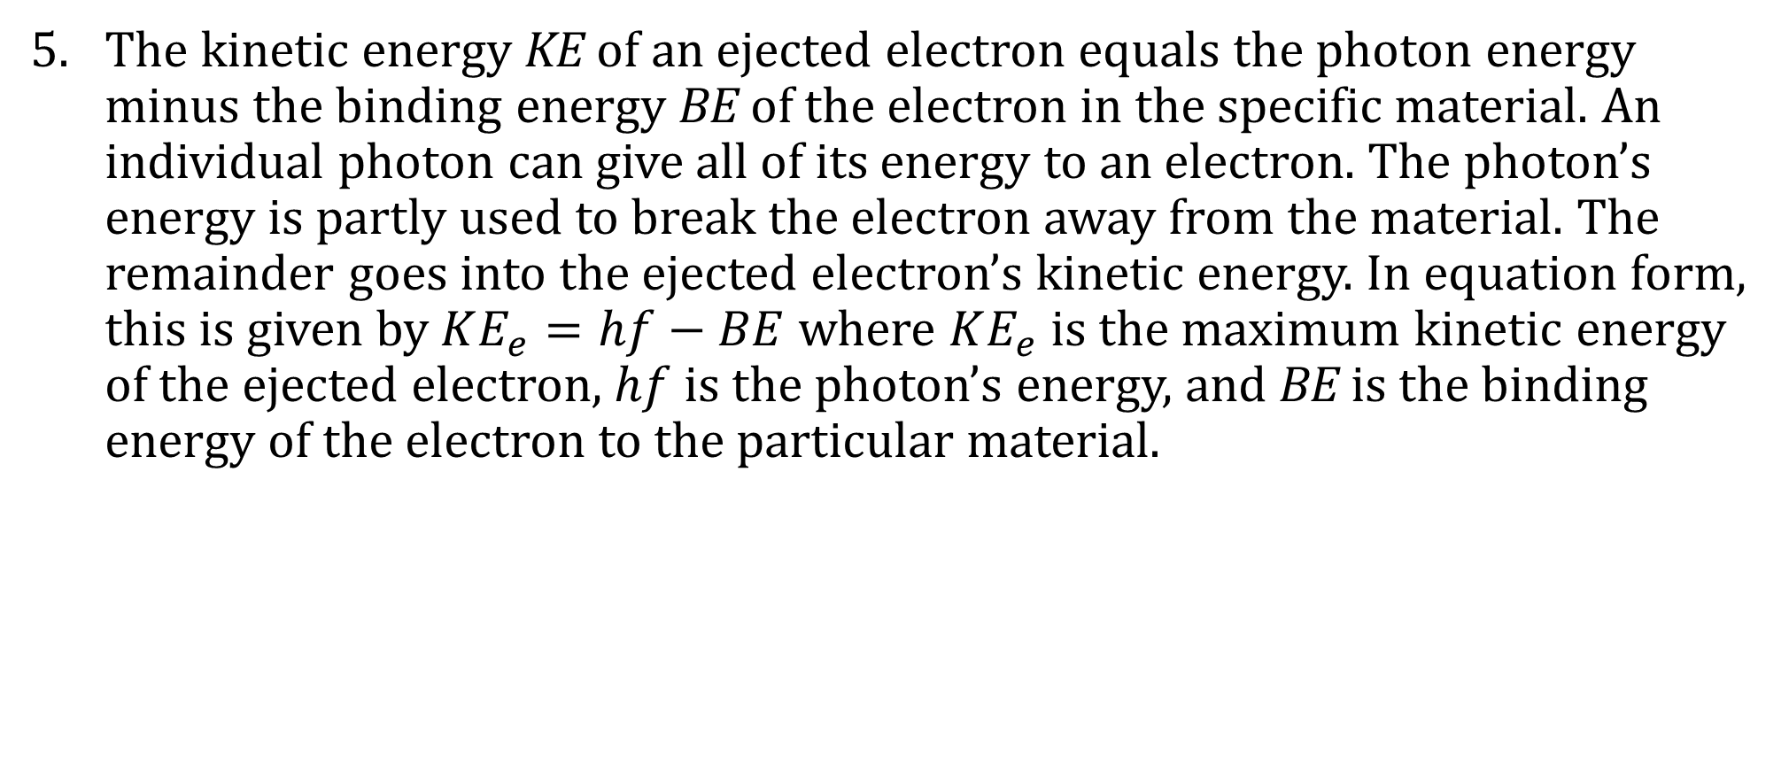
12-05 Photoelectric Effect
The kinetic energy KE of an ejected electron equals the photon energy minus the binding energy BE of the electron in the specific material. An individual photon can give all of its energy to an electron. The photon’s energy is partly used to break the electron away from the material. The remainder goes into the ejected electron’s kinetic energy. In equation form, this is given by $KE_{e}=hf−BE$ where $KE_{e}$ is the maximum kinetic energy of the ejected electron, $hf$ is the photon’s energy, and BE is the binding energy of the electron to the particular material.

Slide 46
12-05 Photoelectric Effect
What is the energy in joules and electron volts of a photon of 250 nm ultraviolet light?
What is the maximum kinetic energy of electrons ejected from cesium by 250 nm UV light, given that the binding energy of electrons from silver is 3.894 eV?
Notes:
$$E=hf$$
$$c=fλ→f=\frac{c}{λ}$$
$$f=\frac{3.00×{10}^{8}\frac{m}{s}}{250×{10}^{−9} m}=1.2×{10}^{15} /s$$
$$E=\left(6.626×{10}^{−34} J·s\right)\left(1.2×{10}^{15}\frac{}{s}\right)=7.95×{10}^{−19} J$$
Convert to eV
$$7.95×{10}^{−19} J\left(\frac{1 eV}{1.60×{10}^{−19} J}\right)=4.97 eV$$
$$KE_{e}=hf−BE$$
$$KE_{e}=4.97 eV−3.894 eV=1.08 eV$$

Slide 47
12-05 Photoelectric Effect
Uses of the photoelectric effect
  Photovoltaic solar cells
    Light knocks electrons off metal which are then stored in a battery
  Electric eye
    Lights turn on in the dark
      When it is day, the light knocks electrons off a piece of metal which is then filled with a new electron from a circuit. This make current. When the current goes away, the light turns on.
    Automatic faucets, paper towels, toilets, etc.

Slide 48
12-05 Practice Work
Light can change matter. Be a light to the world and change it.
Read
  OpenStax College Physics 2e 29.4-29.6
  OR
  OpenStax High School Physics 21.3

Slide 49
12-06 The Dual Nature of Light
In this lesson you will…
Notes:
OpenStax High School Physics 21.3
OpenStax College Physics 2e 29.4-29.6

Slide 50
12-06 The Dual Nature of Light
Light behaves as a wave
  Diffracts
  Reflects
  Interference
Light behaves as a particle
  Discrete energy
    Blackbody radiation
  Photoelectric effect
  Momentum

Slide 51
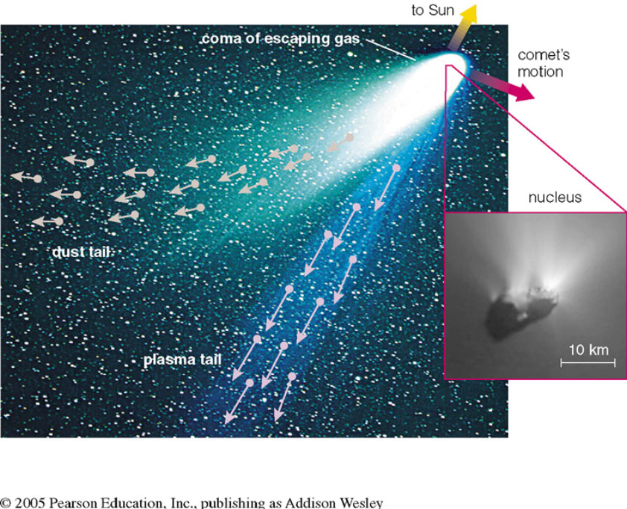
12-06 The Dual Nature of Light
Momentum of light
  Light from the sun pushes a comet’s tail away

Slide 52
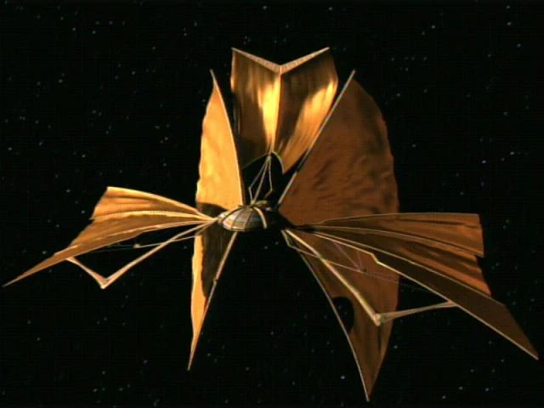
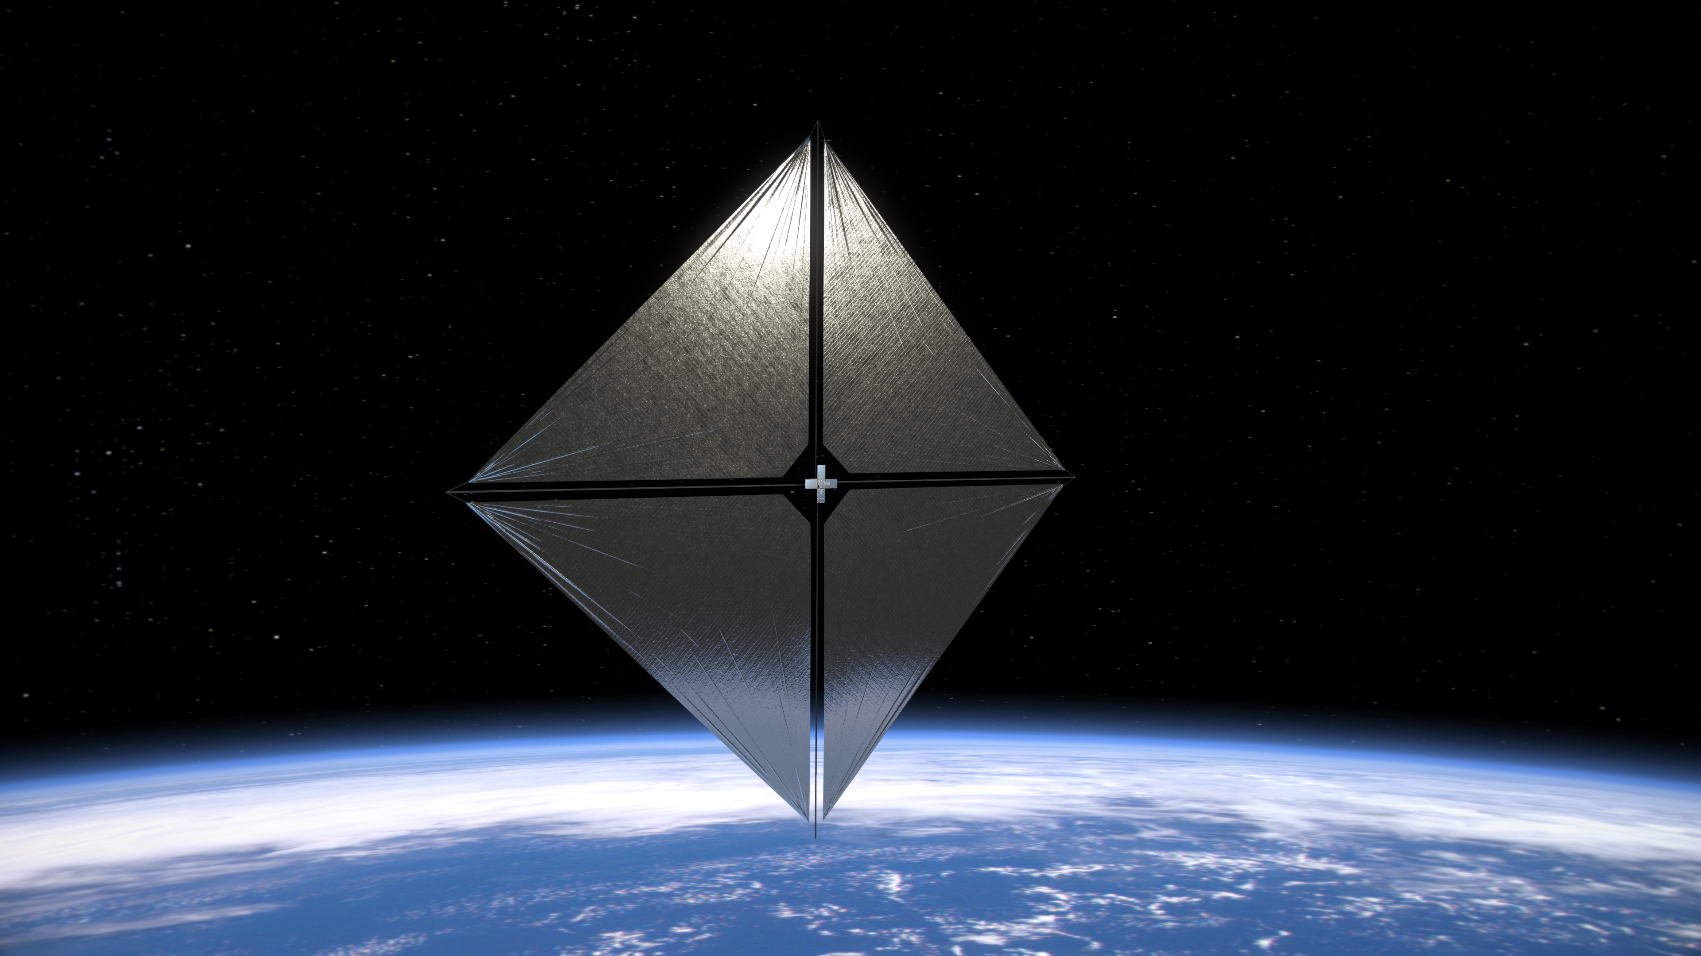
12-06 The Dual Nature of Light
Momentum of light
  NASA is developing a sail spaceship that is pushed away from the sun using a sail that is hit by the sunlight
Notes:
Left: NASA sail ship
Right: Bajoran lightship from Star Trek: Deep Space 9

Slide 53
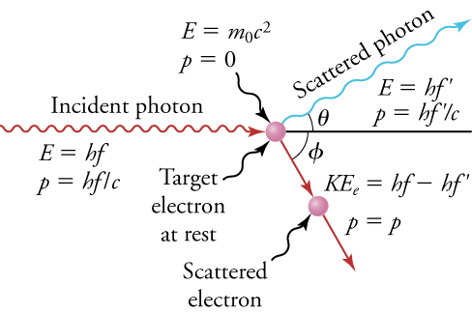
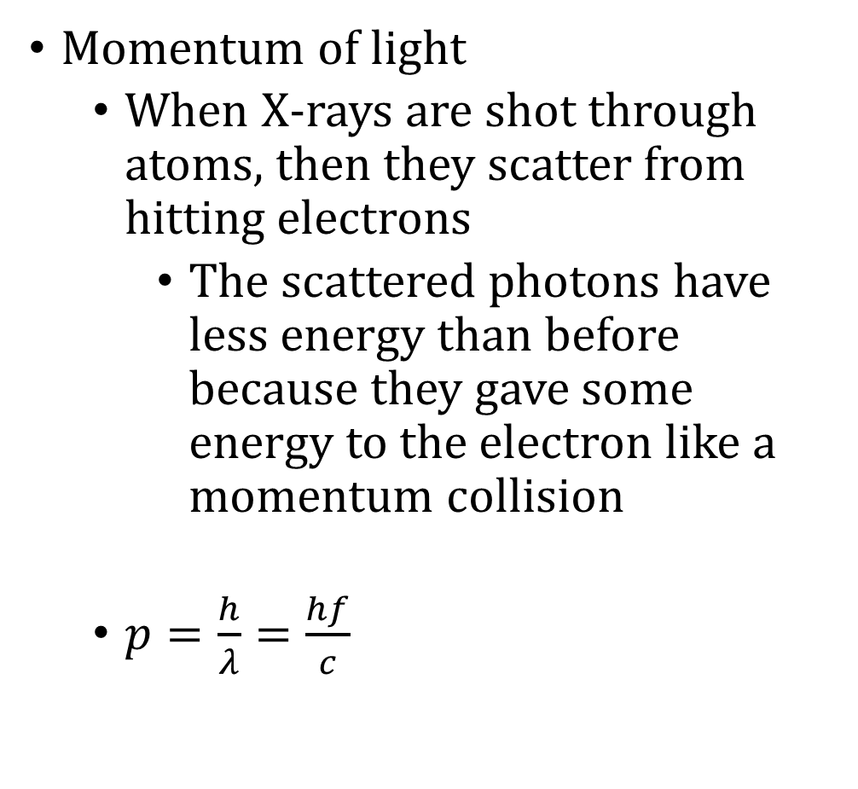
12-06 The Dual Nature of Light
Momentum of light
  When X-rays are shot through atoms, then they scatter from hitting electrons
    The scattered photons have less energy than before because they gave some energy to the electron like a momentum collision
  $p=\frac{h}{λ}=\frac{hf}{c}$

Slide 54
12-06 The Dual Nature of Light
Calculate the momentum of a visible photon that has a wavelength of red light 680 nm.
Find the velocity of an electron with the same momentum.
Notes:
$$p=\frac{h}{λ}$$
$$p=\frac{6.626×{10}^{−34} J·s}{680×{10}^{−9} m}=9.74×{10}^{−28} kg\frac{m}{s}$$
$$p=mv$$
$$9.74×{10}^{−28} kg\frac{m}{s}=\left(9.11×{10}^{−31} kg\right)v$$
$$v=1070\frac{m}{s}$$
This is nonrelativistic

Slide 55
12-06 The Dual Nature of Light
What is the energy of the electron, and how does it compare with the energy of the photon?
Notes:
Electron
$$KE=\frac{1}{2}mv^{2}$$
$$KE=\frac{1}{2}\left(9.11×{10}^{−31} kg\right){\left(1070\frac{m}{s}\right)}^{2}=5.21×{10}^{−25} J$$
$$5.21×{10}^{−25} J\left(\frac{1 eV}{1.60×{10}^{−19} J}\right)=3.26×{10}^{−6} eV$$
Very small
Photon
$$E=hf=\frac{hc}{λ}$$
$$E=\frac{\left(6.626×{10}^{−34} J·s\right)\left(3.00×{10}^{8}\frac{m}{s}\right)}{680×{10}^{−9} m}=2.92×{10}^{−19} J$$
$$2.92×{10}^{−19} J\left(\frac{1 eV}{1.60×{10}^{−19} J}\right)=1.83 eV$$
About a million times more energy than the electron

Slide 56
12-06 The Dual Nature of Light
Particle-Wave Duality
  Light waves can act as particles
  Particles can act as waves
    Electrons can interfere with each other
    Electron currents can cancel out
  All matter is both waves and particles

Slide 57
12-06 Practice Work
We are called to a duality: Be in the world, but not of the world.

